Slide 1
MPPC
(64ch)
MPPC
(64ch)
CIRASAME module
40V-70V
CITIROC4
(32ch)
CITIROC3
(32ch)
CITIROC2
(32ch)
CITIROC1
(32ch)
Probe
output
MAX
19232
Comparator
output
Analog high-gain
output
128
FPGA
DIP Switch
4
Analog
switch
SDRAM
GTX
AD9220
2
2
Logic
translate
Jitter
cleaner
Logic
translate
Power
supply
NIM
SFP1
SFP2
Coaxial
Coaxial
Coaxial
Coaxial
DC +20-35V

Slide 2
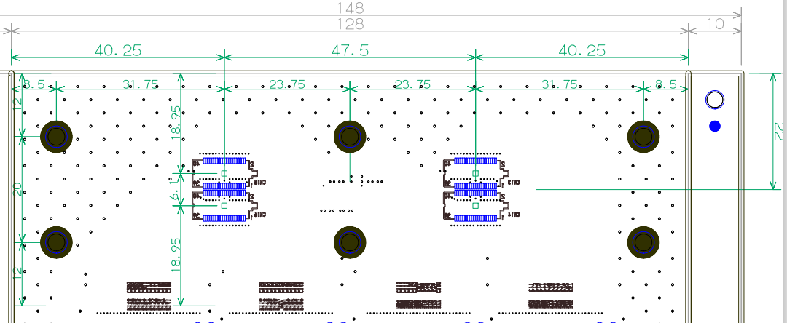
40.25
47.5
40.25
8.5
31.75
23.75
23.75
31.75
8.5
15
22
18.95
6.1
20
18.95
15

Slide 3
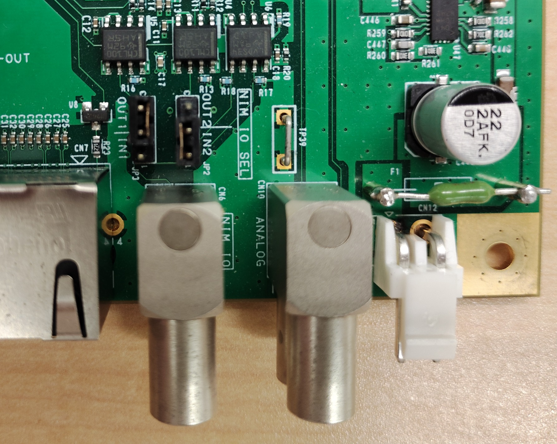
Analog/probe out
NIM IO

Slide 4
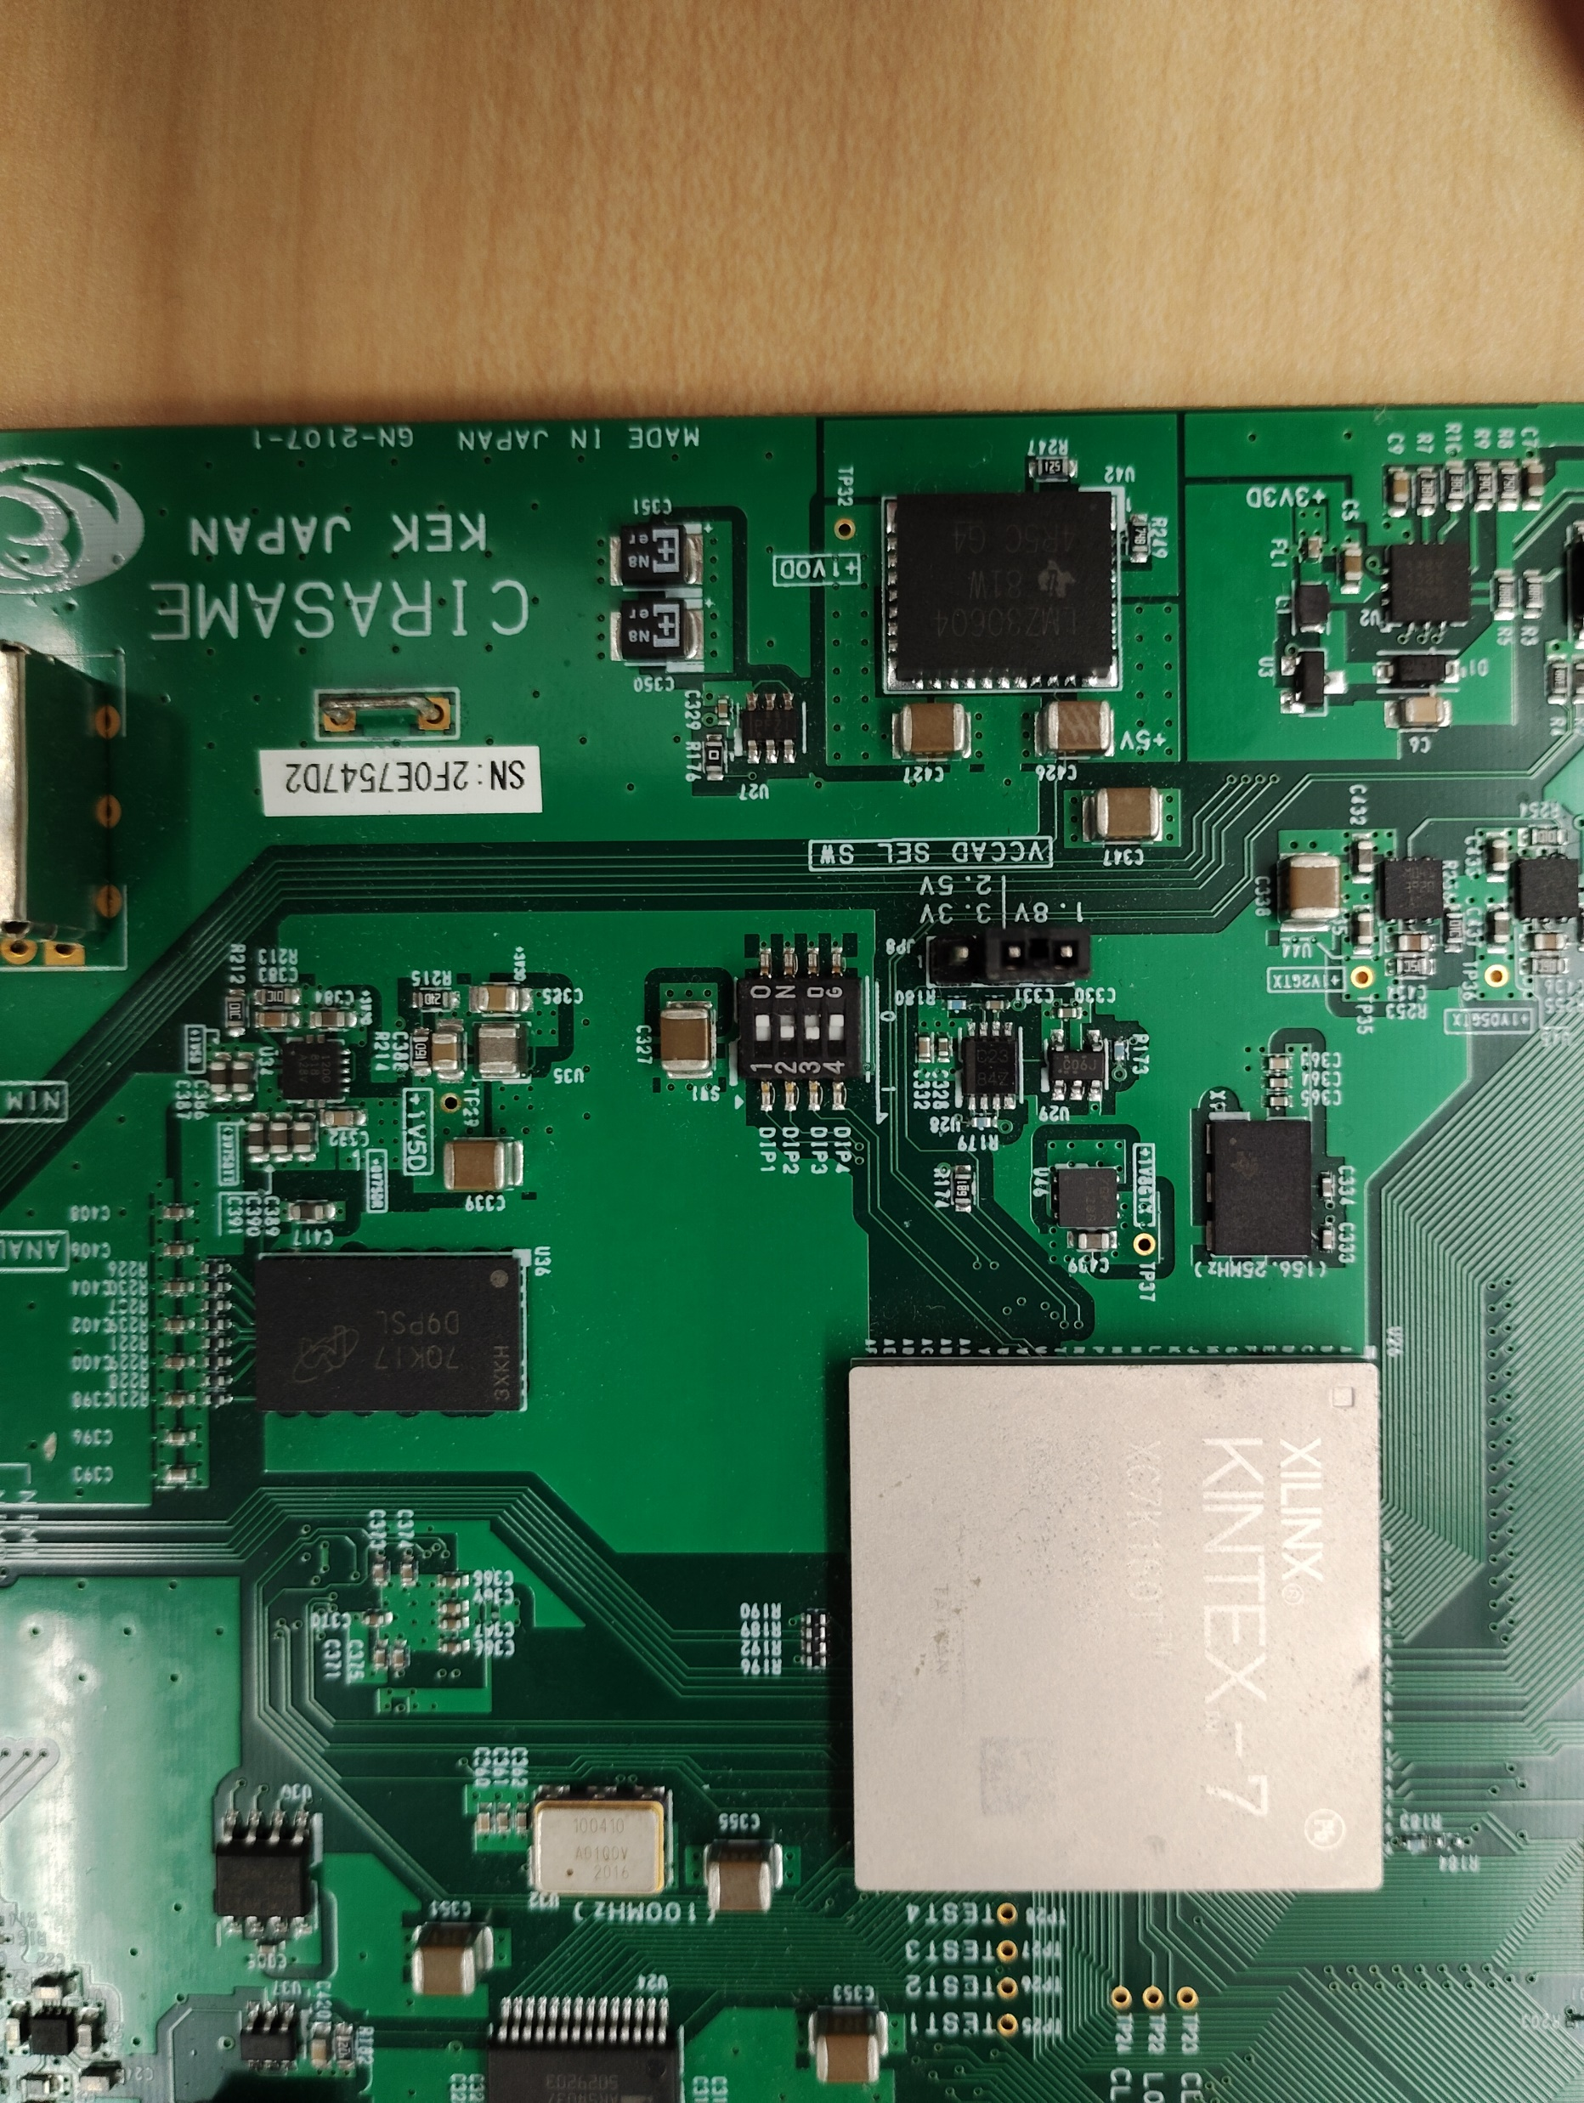

Slide 5
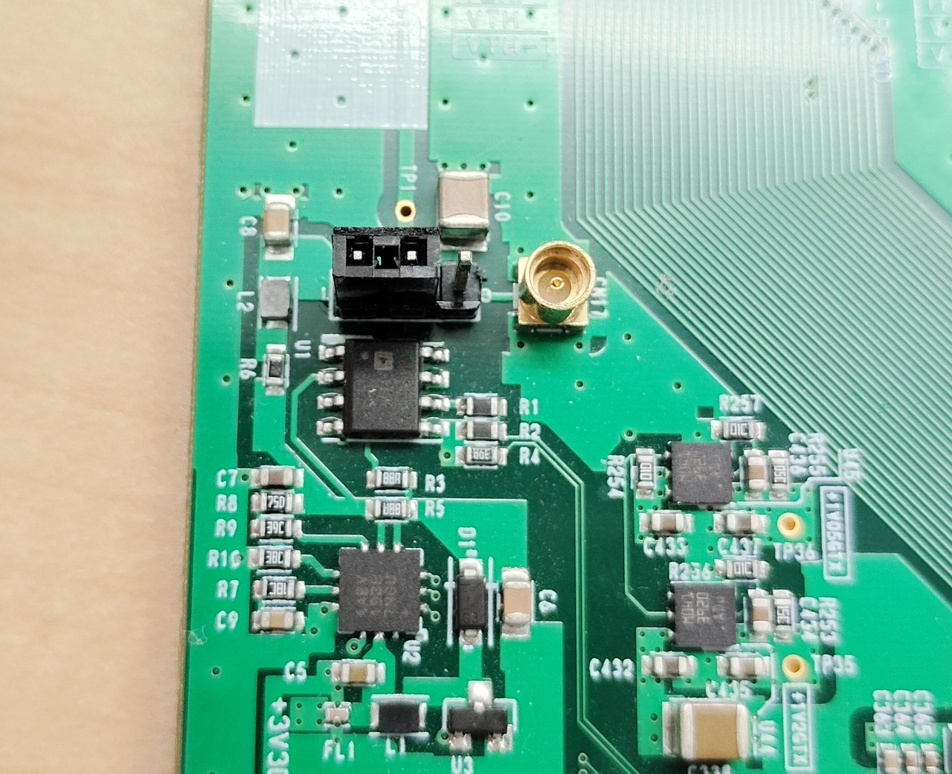
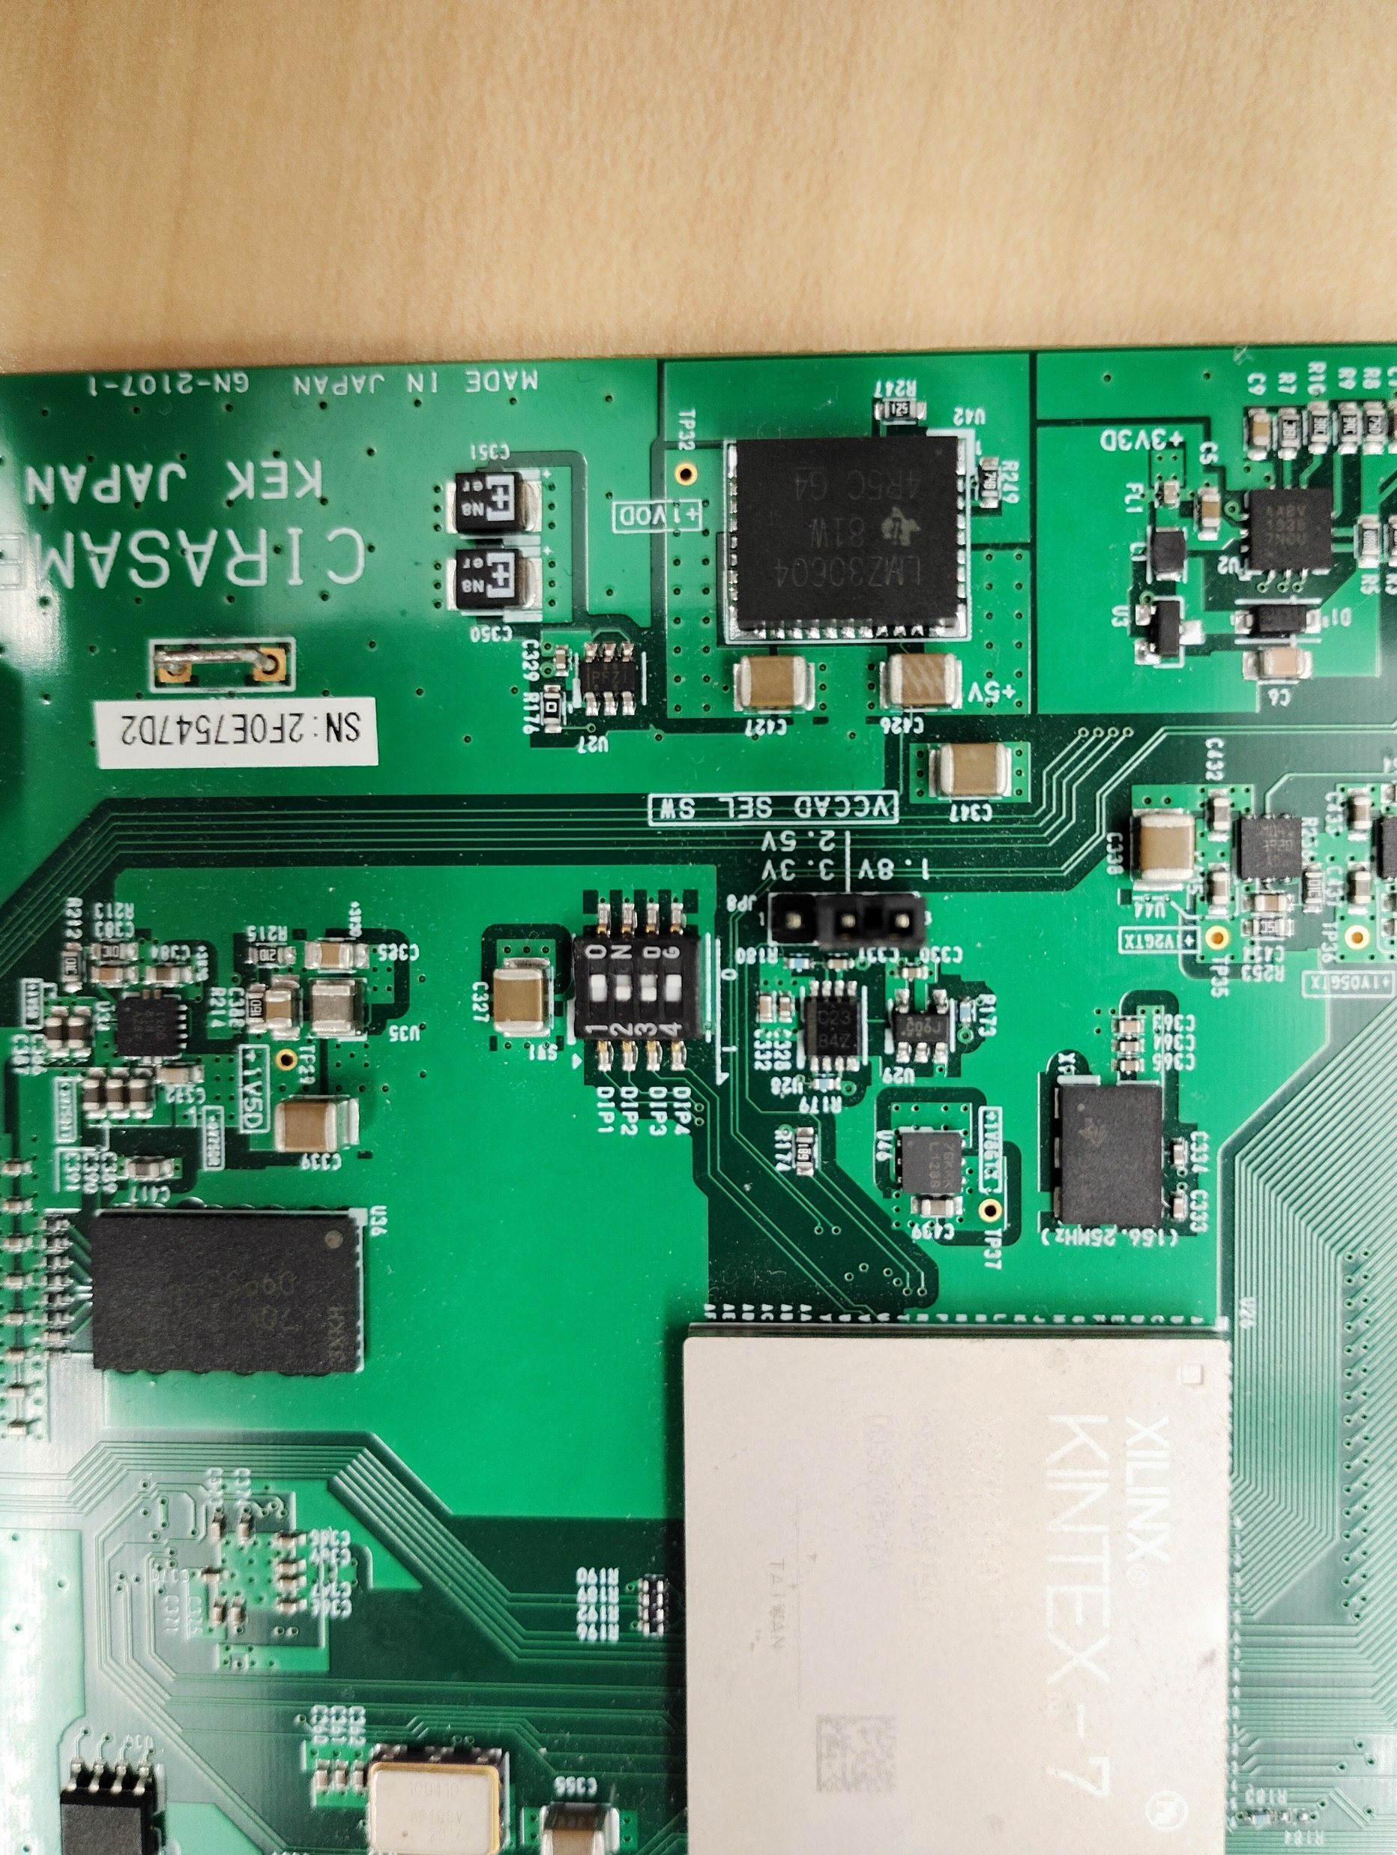
Bias selection
External bias

Slide 6
Discriminator
outputs
CITIROCs
Streaming
TDC
SiTCP
TCP
NIMIN-1
Scaler
RBCP
NIMIN-2
Trigger
Heartbeat
Unit
LACCP
MIKUMARI
NIMOUT-1
IO
Manger
NIMOUT-2
System
clock
MMCM
Local oscillator clock
LACCP trigger
Heartbeat signal
TCP connection

Slide 7
Oscillator
100MHz
MMCM
Local clock
domain
PCS/PMA
SFP
NIM-OUT 1
NIM-IN2
Local bus
SiTCP/XG
Hold
Generator
TCP
NIM-OUT 2
HOLD
CITIROCs
IO Manager
RBCP
128
Analog output
CDC
AD9220
AD9220
CITIROC
Controller
MPPC bias
MAX1932
MAX1932
Controller
Local bus
controller
CECE
62002
CECE62002
Controller
Inside
FPGA
Flash
memory
FMP
SDS
SEM
XADC

Slide 8
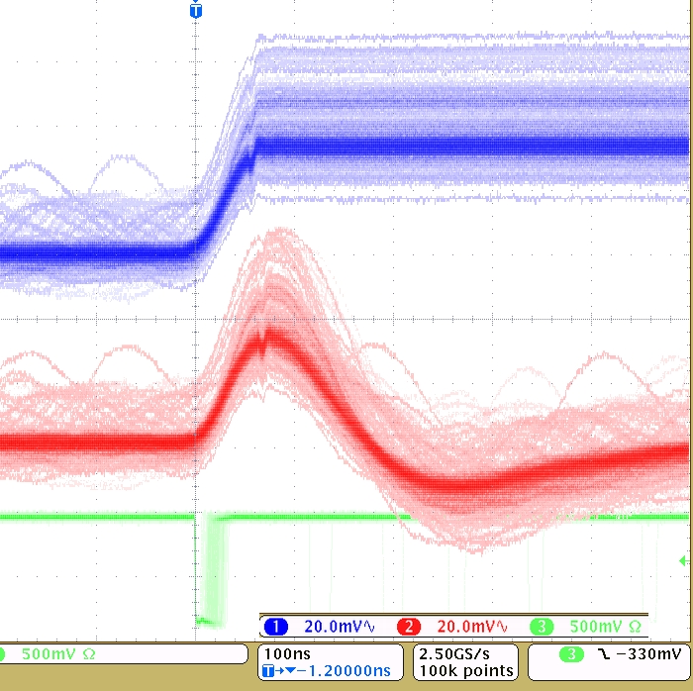
Smaller delay amount
Analog output
w/ HOLD
Incoming HOLD signal
MSB
LSB
Mask register:
11111111’11111111’11110000’00000000
Probe signal
(Slow Shaper output)
Larger delay amount
MSB
LSB
Mask register:
11111110’00000000’00000000’00000000

Slide 9
TDC 64-127 ch
TDC 0-63 ch
MPPC
MPPC
CITIROCs
0: Secondary (RX)
SFP1
0
Data link
NIM
IO
Analog
signal
NIM IN1: Not in use
NIM IN2: Trigger in
NIM OUT1: Discriminator (arranged by IO manger)
NIM OUT2: DAQ signals (arranged by IO manger)

